Slide 1
Navigating Behavior

Slide 2
Who we are and what we do
Amanda Steel, MA
  Behavior Support Coordinator, Hamilton County Developmental Disabilities Services
  Behavior Support Consultant, Freeman Center
Bree Stepp, BCBA, COBA
  Certified Ohio Behavior Analyst
  Board Certified Behavior Analyst, Freeman Center
Dr TJ Nestheide, PsyD
  Behavioral Health Director, Freeman Center
  Associate Professor of Clinical Psychiatry and Behavioral Neuroscience at the University of Cincinnati School of Medicine

Slide 3



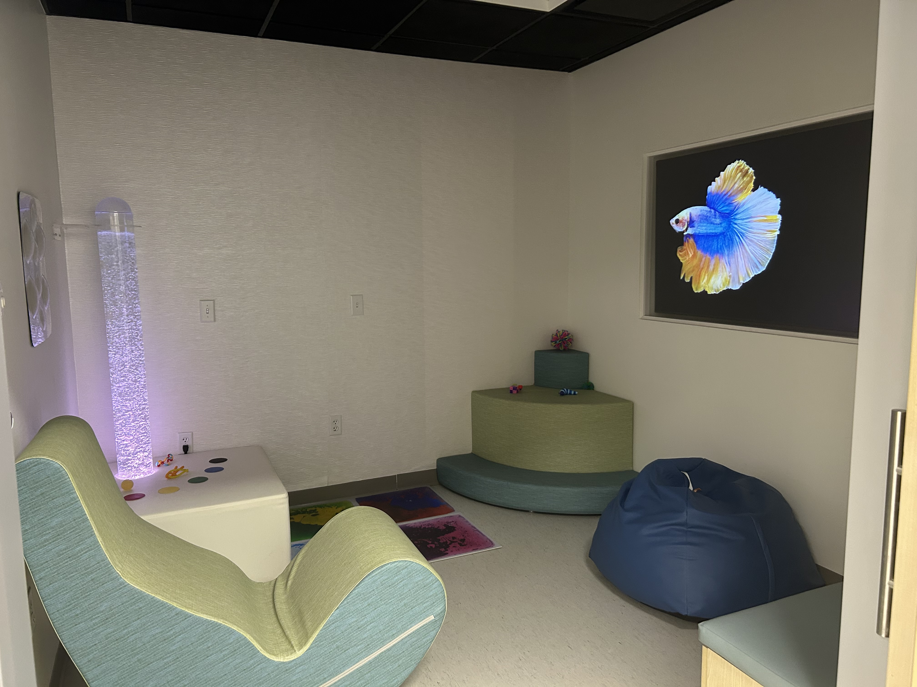


Where we work
The Timothy Freeman, MD, Center for Developmental Disabilities

Slide 4
Navigating Behavior
Executive Summary
Individuals with Down syndrome, like all people, use behavior as a form of communication. When internal needs, emotions, or discomfort cannot be effectively expressed, behaviors may emerge that disrupt daily routines.
This webinar and the Navigating Behavior Guide provide parents, families and caregivers with a practical framework for understanding and addressing challenging behaviors in individuals with Down syndrome. By understanding behavior as a function, caregivers can promote more effective communication, strengthen relationships and improve overall quality of life

Slide 5
Navigating Behavior
Disclaimer
This resource is not a substitute for collaborating with qualified professionals. Some challenging behaviors and situations demand immediate response from emergency services.
If there is an immediate risk of harm to the individual with Down syndrome or others, first responders or crisis services are recommended. If the situation requires additional support services, caregivers should mention that the individual has Down syndrome and provide any relevant details to help first responders interact with the individual with Down syndrome.

Slide 6
How do we understand challenging behavior?
Functions of behavior
All behavior has root causes and factors that maintain the behavior, these are the ‘function’ of the behavior
Common functions of behavior include
  medical problems
  escape from demands
  gaining attention
  sensory challenges
  access to tangible items
  behaviors may also be related to previous traumas

Slide 7
How do we understand challenging behavior?
Data collection
Describe the behavior in as much detail as possible:
  What is the behavior, what does it look like?
  How often does it happen?
  Where does it happen?
  When does it happen?
  What is going on in the environment when the behavior happens?
  Who does the behavior happen with (family, staff, teachers, etc.)

Slide 8
How do we understand challenging behavior?
Data collection
Data can be collected using an A-B-C data sheet to help see patterns in the behavior
  Antecedent (what happened before the behavior occurred)
  Behavior (description of the target behavior)
  Consequence (what happened after the behavior occurred)

Slide 9
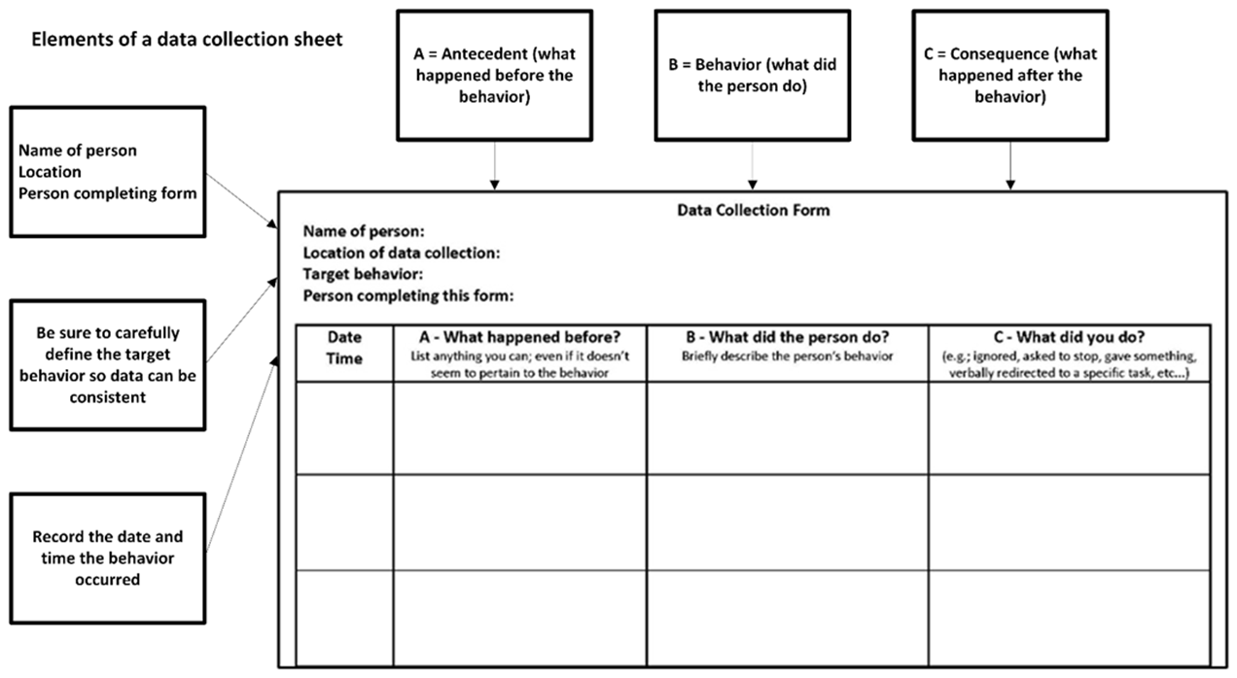
How do we understand challenging behavior?
Data collection

Slide 10
How do we understand challenging behavior?

Slide 11
How do we understand challenging behavior?
Common causes of challenging behavior
Communication concerns
Ongoing medical concerns
Physical pain
Medication changes or side effects
Recent losses
Recent changes in routine/structure of the person’s typical day or activities

Slide 12
How do we understand challenging behavior?
Age-related considerations for children
In addition to the common causes, consider:
Problems/changes to routine or activities at school
Problems with peers
Problems with siblings/family

Slide 13
How do we understand challenging behavior?
Age-related considerations for adolescents
In addition to the common causes, consider:
If female, have they recently started their period or could they have period pain
Growing pains, weight gain
Starting or going through puberty
Problems at school or changes to routine or activities
Problems with peers
Problems with siblings/family

Slide 14
How do we understand challenging behavior?
Age-related considerations for adults
In addition to the common causes, consider:
Problems or changes to routines, activities at work, or day programming
Problems with or changes in direct care staff
Changes in relationships with friends or family

Slide 15
How do we understand challenging behavior?
Age-related considerations for older adults
In addition to the common causes, consider:
Is the person showing signs of cognitive decline
  Consider using the NTG-EDSD Screening Tool
Problems with or changes to routines, activities at work, or day programming
Problems with or changes in direct care staff
Recent losses of friends or family

Slide 16
How do we understand challenging behavior?
Summary
We collect data on the behavior
We look for patterns in the data to determine the function of the behavior
We consider common causes of challenging behavior
We consider additional age-related concerns that may be leading to challenging behaviors
We use this information to develop function-based interventions

Slide 17
How do we intervene with challenging behavior?
*Important note*
Interventions for challenging behavior may initially make the behavior worse. This is because the behavior was the best way for the person to get their needs met, and when that is taken away, they may initially try to engage in more behavior to get to the same end.
Only consistent interventions can help the person learn that the behavior does not work as well as the intervention does to meet their needs. Any suggestions in this document should serve as a guide to best practices, not as an individualized treatment plan.
Interventions should be reviewed with local doctors or specialists to help determine whether they are appropriate to use in the long term.

Slide 18
How do we intervene with challenging behavior?
Function-based interventions
Once we understand why challenging behavior occurs, we can design interventions
Any intervention should serve the same function as the target behavior
For example, if a person engages in challenging behavior to get attention, interventions should provide the person with a safer way of getting attention:
  Teach the person to ask for attention
  Teach the person to raise their hand
  Use a communication system or visual support

Slide 19
How do we intervene with challenging behavior?
For behaviors with a medical function:
Attempt to determine what the medical issue is by contacting physicians or mental health professionals
Keep notes about the behavior and how often it is happening
Offer support to ease pain or discomfort as appropriate
Consider any recent medication changes or side effects from routine medications

Slide 20
How do we intervene with challenging behavior?
For behaviors with an escape function:
Particularly for academic or job tasks, ensure the person understands the task
Offer a safe way to get away, such as offering a quiet space for the person to calm down
Allow the person to take a break, then return to their expectations after a set amount of time
  Use a timer to indicate time until a break
  Use a first-then visual to remind the person of the order of events (first work, then break)

Slide 21
How do we intervene with challenging behavior?
For behaviors with an attention-seeking function:
Plan regular time to give positive, one-on-one attention
  Read a book together every night before bed
  Schedule 20 minutes every day at a designated time to
  give undivided attention to the person
  Use visual supports so the person knows when they will
  get your attention
Catch the person being good and offer praise for safe and desirable behaviors
Let the person know when you will spend one-on-one time with them

Slide 22
How do we intervene with challenging behavior?
For behaviors with an access to tangible items function:
Let the person know when they can access the object (or person, or activity)
Use a visual schedule to show when that object (or person, or activity) will be available
Offer a similar alternative when the desired item is not available right away
  For example, always offer easily accessible healthy snacks to help with waiting for meal or snack times

Slide 23
How do we intervene with challenging behavior?
For behaviors with a sensory function:
Notice what type of sensory stimuli the person seeks or avoids; consider all 8 senses: sight, touch, taste, smell, sound, proprioception (where the body is in space), interoception (internal sensations), and vestibular (balance)
Some senses may be over-sensitive (leading to avoidance) while others may be under-sensitive (leading to seeking)
Provide access to sensory supports that match what the person is seeking (swing, weighted blanket, scent kit, squishy toys, etc.)
If the person is avoiding certain input, provide a way to avoid or block these inputs (sound-blocking headphones, quiet area, sunglasses, loose clothing, etc.)

Slide 24
How do we intervene with challenging behavior?
For behaviors related to previous trauma:
Learn about the person’s trauma history; look for patterns of behavior that were used for survival and whether the current behaviors are similar
Remind the person that you are a safe person and are there to help; use language that communicates they are in control while you are there to provide what they need; say things like “I want this to be a safe space for you”
Offer empathy, recognize the person’s survivorship, and thank them for sharing their history with you

Slide 25
How do we intervene with challenging behavior?
*Important note*
Self-injury / Self-harm behavior
Intense, high-frequency self-injury may require protective equipment, medication management, and multiple people
Self-injury that causes, or has caused, tissue damage, broken skin, or injuries should not be addressed without significant support and planning
NDSS or your local affiliate group can help you find professionals near you
If restrictive interventions are indicated (emergency medications, protective equipment, etc.), state and local rules may dictate how those supports are provided, funded, or monitored

Slide 26
How do we intervene with challenging behavior?
Self-injury / Self-harm behavior
You can work to understand (through observation and data collection) the function of the behavior, and plan interventions
  For example, if the person repeatedly pushes their hand into their chin, data collection may find a medical function related to tooth pain. Treating the tooth pain may result in no more self-injury.
Self-injury can be a particularly effective behavior with an attention function because caregivers respond to keep the person safe, which may reinforce the behavior
Self-injury may have an escape function if the person is removed from a demanding or difficult situation, also potentially reinforcing the behavior
It is important to consider communication alternatives so the person can meet the same need without self-injury

Slide 27
How do we intervene with challenging behavior?
*Important note*
Aggressive behavior
Aggressive behavior that is high-intensity, high-frequency and/or causes injury is best treated by professionals
Treatment may require use of medications, protective equipment, and highly structured and consistent intervention
NDSS or your local affiliate group can help you find professionals near you
If restrictive interventions are indicated (emergency medications, protective equipment), state and local rules may dictate how those supports are provided, funded, or monitored

Slide 28
How do we intervene with challenging behavior?
Aggressive behavior
"Aggression" is used as a catch-all for any number of specific presentations (hitting, kicking, slapping, pushing, pinching, biting, head-butting, throwing items, etc.)
It is important in your data collection to clearly define what aggression looks like for the specific person
Aggressive behavior may be an attempt to modify the environment
  If someone makes loud noises and the person aggresses toward that person, the behavior may have an escape function if the noises stop. Providing the person with a break, offering noise-cancelling headphones, or addressing the noise with the other person can all be more effective ways to escape the loud environment.
Aggression can have an access-to-tangible function if the person is given a preferred item to make them stop aggressing
Although done with best intentions, these interventions may reinforce the behavior

Slide 29
How do we intervene with challenging behavior?
*Important note*
Elopement behavior
Elopement can be minor (running out of the room) but can range in severity (running into traffic, going missing)
Significant elopement may require first responders, crisis intervention services, and other agencies
Intervention for elopement should involve trained professionals
Some interventions for elopement may be considered rights restrictions or aversive interventions (automatic door locks preventing egress, use of cameras to monitor the person, use of GPS or other tracking devices) and may require additional levels of approval and oversight

Slide 30
How do we intervene with challenging behavior?
Elopement behavior
Elopement often serves an escape function for the person, but all functions should be considered
  In situations where the person elopes and is chased or followed, this may be an attention function
  If the person consistently elopes to go to a preferred place or to find a preferred item, it may be a tangible function

Slide 31
How do we intervene with challenging behavior?
Elopement behavior
There are technology-based supports marketed to people with disabilities and their families; many of these can be helpful but need to be considered for the specific person
  A GPS tracking watch – what if the person does not like the feeling of the watch on their arm?
  AirTags, or other tags with GPS locators – will the person leave the device alone if it is in a pocket?
  In some cases, these can be sewn into clothing or shoes - what happens if the person elopes without their shoes?
Some of these tools may be rights restrictions or aversive interventions depending on age, guardianship status, and location; work with professionals who understand the relevant regulations

Slide 32
How do we intervene with challenging behavior?
Elopement behavior
Another important consideration with elopement is whether the person is drawn to water
Unfortunately, there are frequent news stories of people with disabilities who go missing and are found deceased or injured in or near bodies of water
Swimming lessons and/or water safety training are highly recommended for all people with disabilities, particularly if they are drawn to water and have elopement behaviors

Slide 33
Navigating Behavior
Final thoughts
Understanding and intervening with challenging behavior can be difficult, time-consuming, and frustrating at times
It is important to learn why the behavior is occurring and to design interventions to reduce or eliminate the behavior
Addressing behavior should involve the person’s entire team (family members, school staff, employment or day program staff, social service agencies, and other professionals)
Despite the challenges, it can be rewarding to help the person learn new, more efficient ways to meet their needs, reach their goals, and improve their quality of life

Slide 34
Thank you!
Questions?

